Slide 1
How to Make a Poster
Summer Undergraduate Research 2017
Shelley Pressley

Slide 2
Nuts and Bolts of getting it printed
Create the poster in Power Point (templates available on the website)
https://summerresearch.wsu.edu/poster-symposium/
Have your poster reviewed by all co-authors – give them time and incorporate their edits
Submit your poster for printing by Tuesday 5:00 pm

Slide 3
Nuts and Bolts of getting it printed con’t
Ask your Program Director where you should print your poster
The Biomedical Communications Unit (BCU) can print posters if you have a Purchase Order (PO)
Make sure you are either listed on an existing purchase request or bring one with you
Pick up your poster by Thursday Aug. 3 and check it

Slide 4
Poster Symposium – August 4
Arrive at 8:15 (with poster) at the CUE atrium (2nd floor)
Pick up nametag, sign-in, hang your poster (we will provide push pins and poster boards)
Group photos at 8:30
Welcome remarks and keynote talk at 9:00 in CUE 202
Poster Symposium open to the public 10:00-1:00
Food (sandwich fixings and beverages) available to presenters
Take poster down and help put away poster boards
Celebrate!

Slide 5
Volunteers needed to help…
Tear Down After the Event: Friday August 4 from 1:00 – 2:00 return poster boards…Ideally 10 students
Please sign-up on the sheet passed around

Slide 6
What to expect…
You will talk and interact with many people including faculty, graduate students, undergraduates, parents, deans, chairs, upper administration, maybe even the president…
Some people will understand a lot about what you did…others will have no idea what you did. Be prepared for both
Practice giving your poster to students in your program and students NOT in your program
Business casual dress is appropriate – so for the guys that means wear a tie if you’ve got one

Slide 7
Importance of the Poster
Final culmination of your summer work
Provide a brief background (BIG picture), your methods or approach to doing the research, as well as results and conclusions
You may (probably should) change the abstract for your poster
Can lay the groundwork for presenting at a national conference or even at your home institution
Will be posted on the website for future researchers

Slide 8
Brainstorm….what should be on a poster?

Slide 9
Contents of a Poster
Title | Your name
Introduction/Abstract | Co-author’s names
Methods/Experimental Design/Procedures | Acknowledgements to Funding agency
Results | Affiliation (i.e. WSU)
Conclusions/Discussion | References
Figures/Pictures/Tables/ Graphs with captions | Future Work or next steps

Slide 10
Let’s critique some posters….
There are lots of examples of posters from previous years, available here http://reu.mme.wsu.edu/index.html
Spend about 10 minutes looking at each poster and list the top three “positives” and top three “negatives” about this poster that you see
As a group we will then discuss each poster

Slide 11
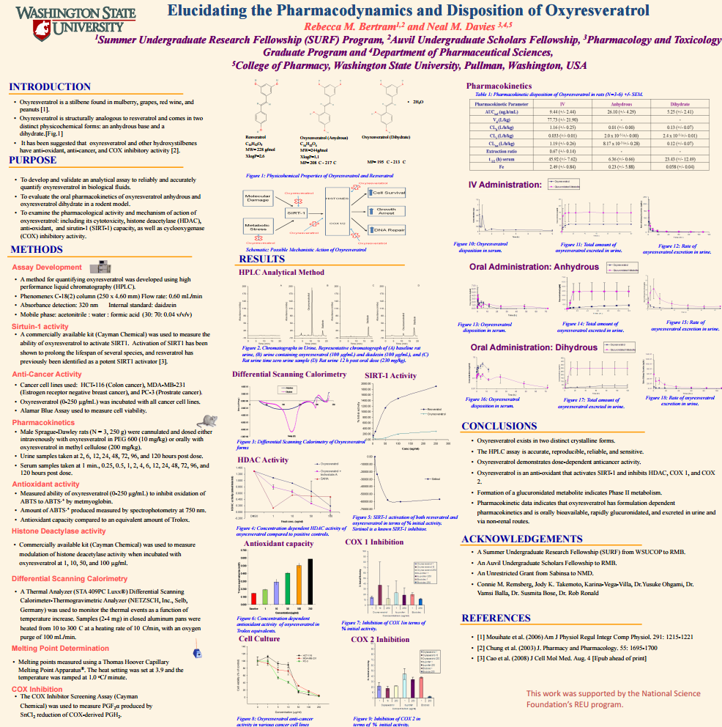

Slide 14
Other suggestions and ideas
Look at previous examples on the website
Note that you may not have all your results and conclusions yet. This is fine. Do your best with what you have, and bring more results to the poster symposium.
Don’t forget to acknowledge your funding source.
Don’t forget to acknowledge your funding source.
Don’t forget to acknowledge your funding source.
Remember – this was a 9-week research experience. Hiccups were bound to happen. If it was easy – anyone could do it!

Slide 15
Questions?
Have Fun!

